Slide 1
Mymensingh Division

Slide 2
Mymensingh Division
It is one of the eight administrative divisions of Bangladesh. It has an area of 10,485 square kilometers (4,048 sq mi) and a population of 12,225,498 as of the 2022 census. It is a major financial center and education hub of north-central Bangladesh.
This division is located near the Indian border and between Dhaka, Sylhet, and Rangpur divisions.
The division of Mymensingh is next to the Indian state of Meghalaya to the north, Dhaka Division on the south, Sylhet Division to the east, Rangpur and Rajshahi Division to the west.
The main rivers of this division are Old Brahmaputra, Sutia , Kangsha , Someshwari , Nitai , Jamuna , Brahmaputra , Kangsha , Bhogai, Banar etc.
Location

Slide 3
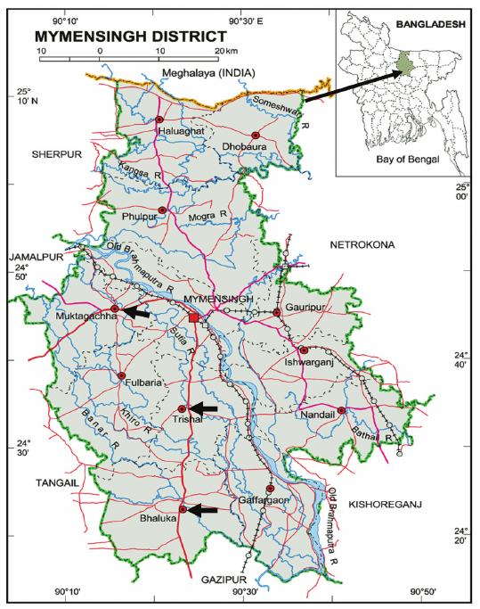
Mymensingh Division
Map

Slide 4
Administration
It was formed in 2015 from districts previously composing the northern part of Dhaka Division. Its headquarters are in Mymensingh city in Mymensingh District.
Mymensingh has four districts which it governs: Mymensingh District, Jamalpur District, Netrokona District, and Sherpur District.

Slide 5
Districts and Upazillas
District | Upazilla
Mymensingh | Bhaluka
 | Dhobaura
 | Fulbaria
 | Gaffargaon
 | Gouripur
 | Haluaghat
 | Ishwarganj
 | Muktagacha
 | Mymensingh-S
 | Nandail
 | Phulpur
 | Tarakanda
 | Trishal
District | Upazilla
Netrokona | Atpara
 | Barhatta
 | Durgapur
 | Kalmakanda
 | Kendua
 | Khaliajuri
 | Madan
 | Mohanganj
 | Netrakona-S
 | Purbadhala
District | Upazilla
Sherpur | Jhenaigati
 | Nakla
 | Nalitabari
 | Sherpur-S
 | Sreebordi
Jamalpur | Bakshiganj
 | Dewanganj
 | Islampur
 | Jamalpur-S
 | Madarganj
 | Melendah
 | Sarishabari

Slide 6
Demography
12,637,472 Population [2022] – Census
1,184/km² Population Density [2022]
0.90% Annual Population Change [2011 → 2022]
Muslims are the predominant religion with 95.57%, while Hindus and Christians are 3.94% and 0.46% of the population respectively. Mymensingh has the highest percentage of Muslims of all divisions of Bangladesh.

Slide 7
Name of Mymensingh
Mymensingh is an anglicization of the name Momen Singh, referring to an ethnic Bengali Muslim saint/ruler called Shah Momin or Momin Singh.
The first independent sultanate of Bengal Alauddin Husain Shah decided to establish a new province in the name of his son Nasiruddin Nasrat Shah in the sixteenth century from where the name Nasirabad or Nasratshahi was in place of Momenshahi. Later Nasirabad was changed to Mymensingh.

Slide 8
HISTORY
Mymensingh’s history stretches far into antiquity. Around the 4th century BC, it was a significant part of the Vedic state of Mahajanapada.
Over the centuries, the region witnessed the rise and fall of various dynasties, including the Gupta Empire, the Sena Dynasty, and the Muslim rulers during the medieval period. Each era left its mark on Mymensingh’s cultural and political landscape.
The Greater Mymensingh region (Mymensingh District along with five other neighboring districts) was created as a Mymensingh district by the British Indian government in 1787. Later it was reorganized in two phases into six districts: Mymensingh, Kishoreganj, Netrakona, Jamalpur, Tangail, and Sherpur. However, Kishoreganj and Tangail are no longer part of Mymensingh, so Mymensingh is comprised of four districts.
On 14 September 2015 Mymensingh was officially announced as a division consisting of four districts.

Slide 9
Mymensingh District and City
Mymensingh district is the most popular district among the four districts, which fall under the Mymensingh division. It is situated in the south by the Gazipur district and east of the Netrokona district. Mymensingh district covers more than 4000-kilometer square consisting of beautiful forests and also valleys. It is indeed a great place to visit for nature lovers.
Mymensingh is a metropolitan city and capital of Mymensingh Division, Bangladesh. Located on the bank of the Brahmaputra River, about 120 km (75 mi) north of the national capital Dhaka,
It is the administrative center of Mymensingh District and Mymensingh Division. As of 2022, Mymensingh City Corporation is the 7th largest city in terms of area and the 8th largest in terms of population in the country, with a population of 576,927 people.

Slide 10
Hub of education
Mymensingh is said to be the educational hub of Bangladesh. In Mymensingh, there is one Medical College, an Agricultural University situated at the picturesque backdrop of the river Brahmaputra, sprawling over 1261 acres of land and Teachers Training College for both males and females.
The third oldest cadet college, Mirjapur Cadet College, established in 1963 was formerly named as Mymensingh Cadet College, and was renamed after Tangail chose to become part of Dhaka Division.
First Girl’s College is located right at the heart of Mymensingh city, however, it still proclaims its existence as Mymensingh Girls Cadet College.
Anandamohon College and Mymensign Zilla School remain to reign as the highest seat of education, whilst the contribution of Vidyamoyee Girls High School is regarded highly for taking girls’ education to a stellar position.
Hundreds and Thousands of nationally and internationally reputed scholars and important personalities have been the proud students of all these institutions, out of which Mymensingh Zilla School stands out clearly.

Slide 11
Hub of education
There are other reputed educational institutions like MUET, Two Technical and Vocational Institutes, one of the two finest private medical colleges by the name of CBMC and the only General University with a focus on Liberal-Cum-Performing Arts Education and Research, Jatiya Kabi Kaji Nazrul Islam University further adds feather to her already star-studded educational crown.
A significant number of educational institutions in the district have contributed to Mymensingh's prominent status. The country’s only female teacher training college, the National Academy for Primary Education, the First Girls' Cadet College, and Kazi Nazrul Islam University are all located in this district. Mymensingh is also home to Bangladesh's largest agricultural university, where students from various regions of Bangladesh, as well as international students, come to pursue higher education in agriculture. The Molecular Agricultural Research Center and Fisheries Research Institute are also established in Mymensingh Sadar. As one of the oldest cities in the country, Mymensingh holds a rich educational legacy.

Slide 12
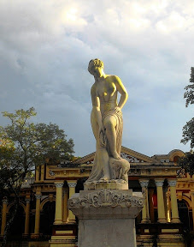
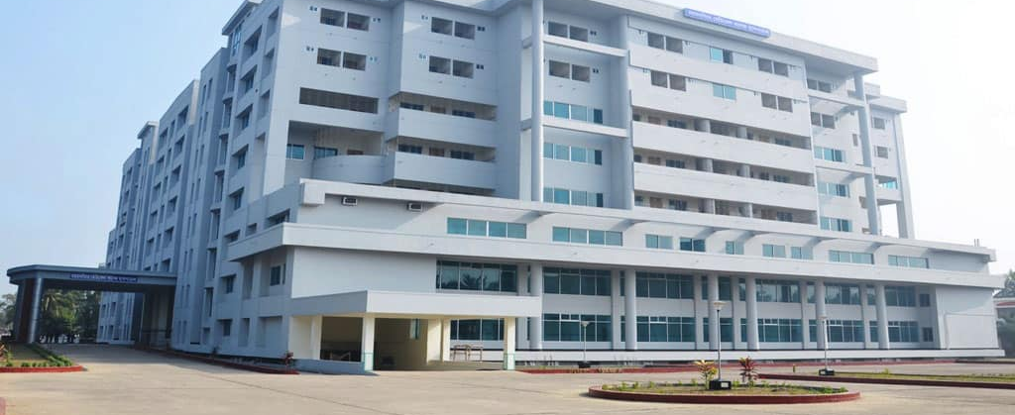
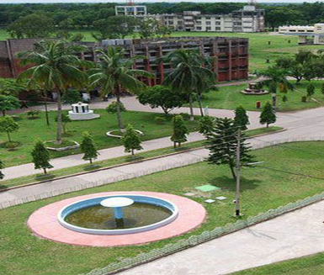
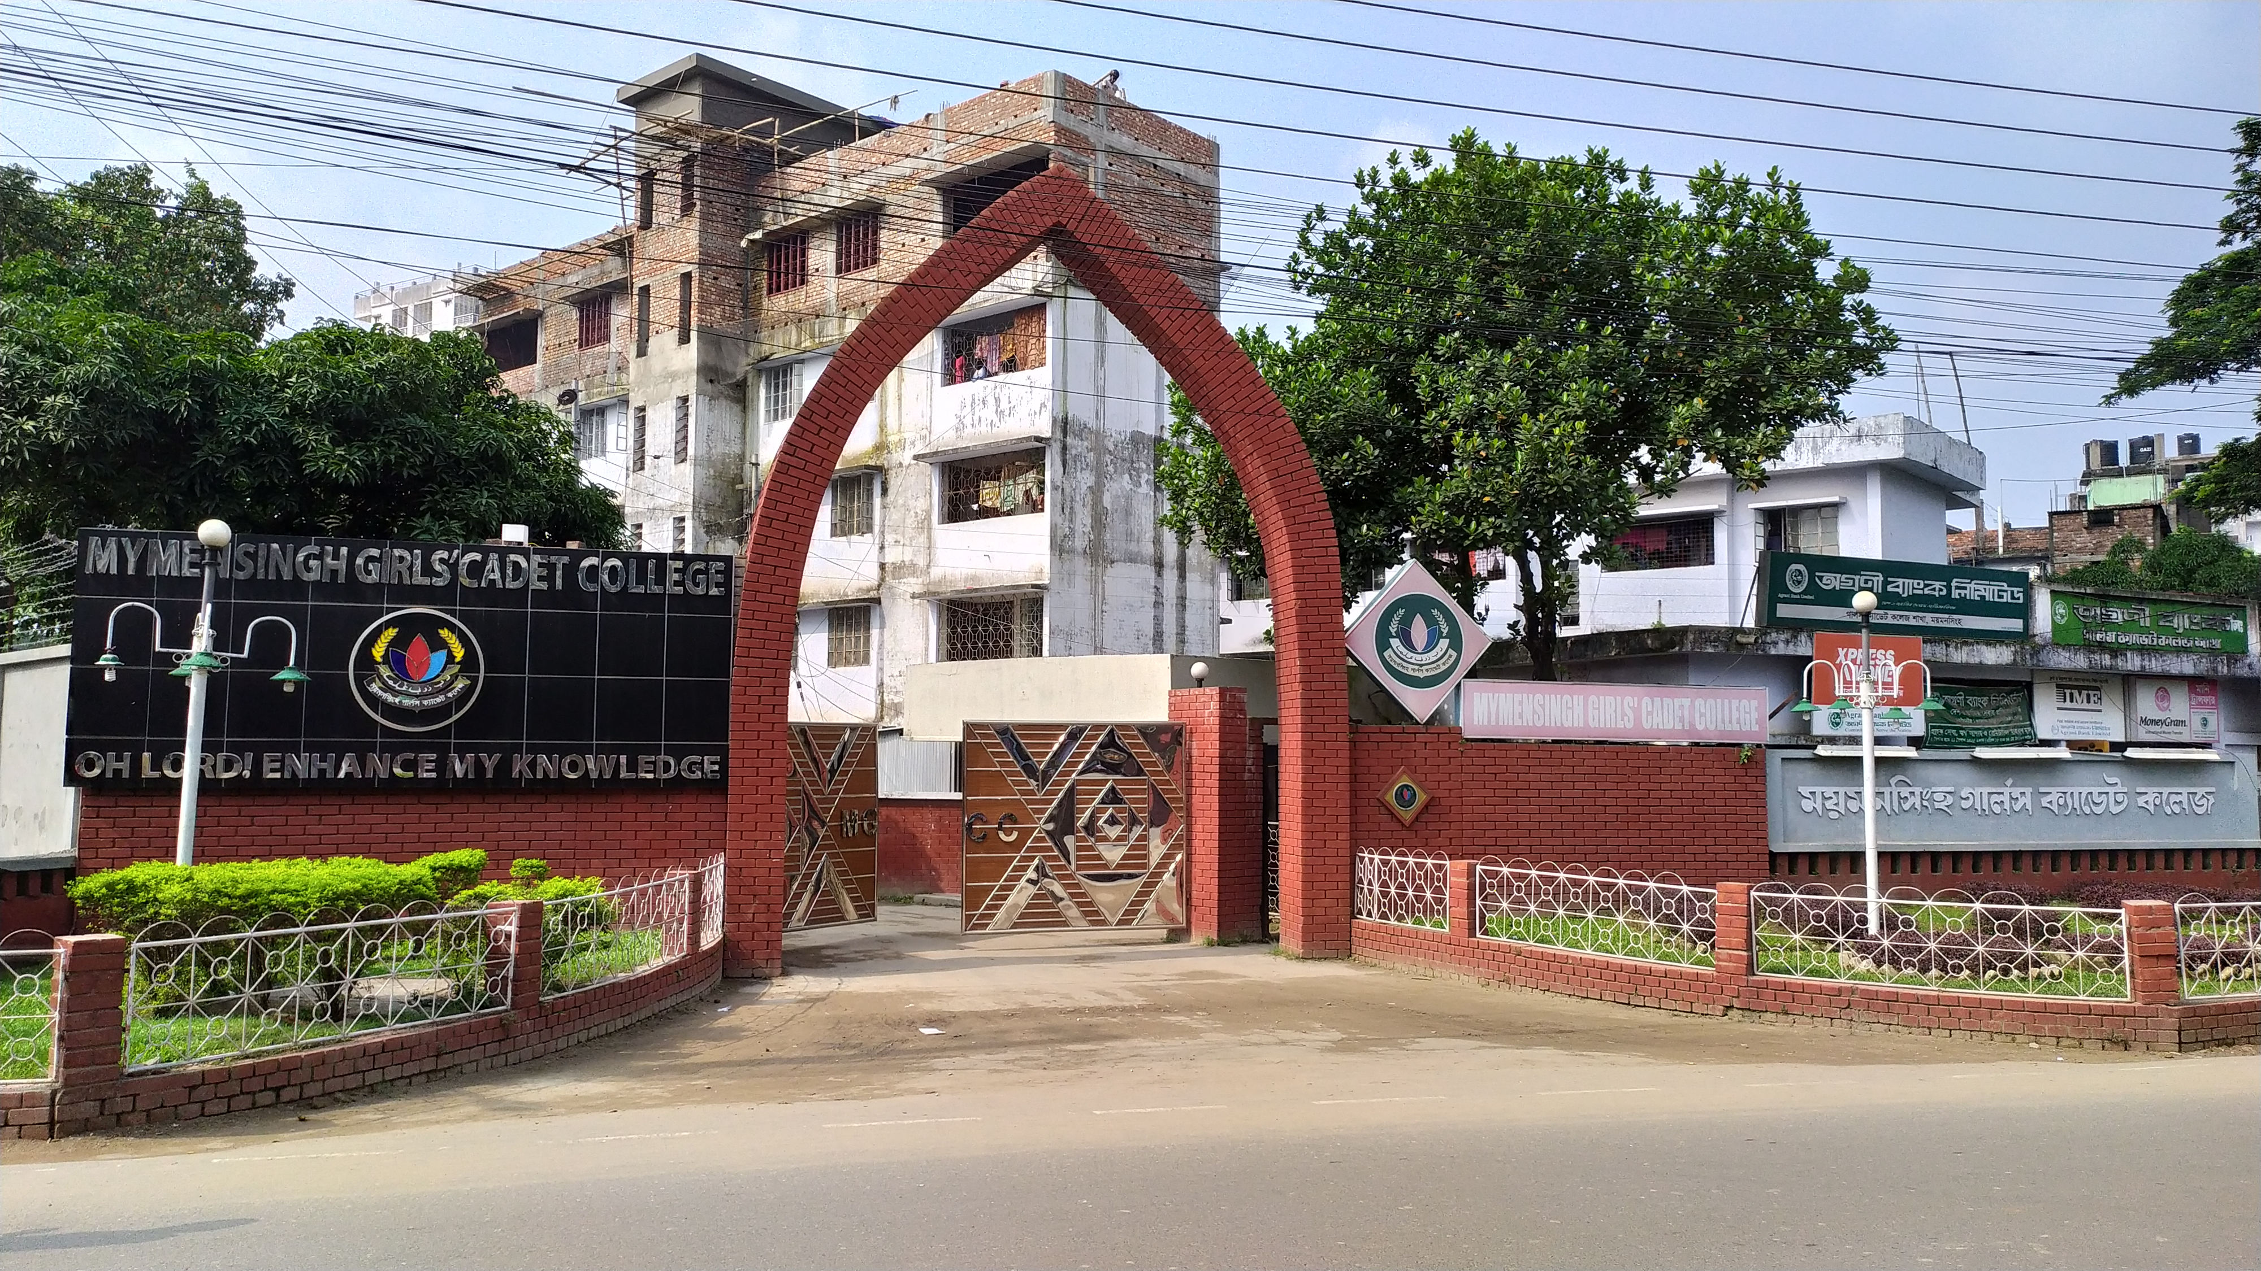
Educational Institutions
Bangladesh Agricultural University
Mymensingh Medical College
Jatiya Kabi Kazi Nazrul Islam University
Mymensingh Engineering College
Community Based Medical College, Bangladesh (CBMCB)
Ananda Mohan College
Nasirabad College
College of Business Science & Technology (CBST)
Teachers Training College
Mymensingh Polytechnic Institute

Slide 13
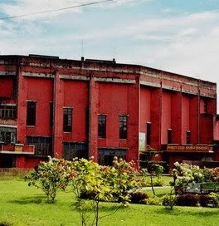
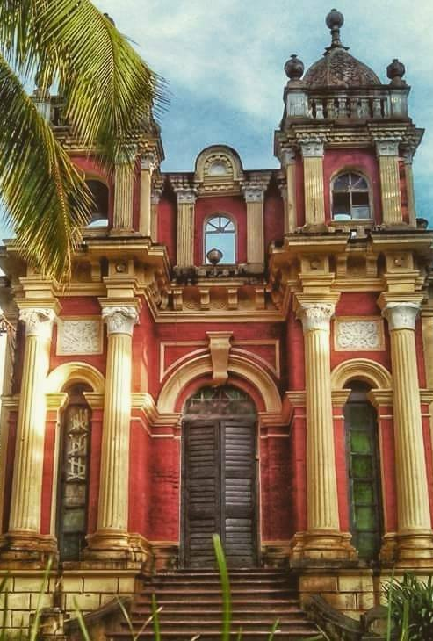
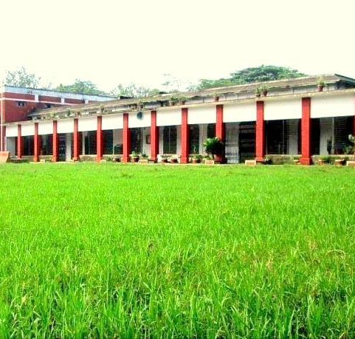
Universities and Colleges
Mymensingh Girls' Cadet College
Shahid Syed Nazrul Islam College
Prime Central College
Alamgir Monsur Memorial College
Cantonment Public School & College
Momenshahi Law College
Advanced Residential Model College
Royal Media College
Haji Kashem ali College Brahmaputra Residential Model College
Mymensingh Islami Academi & College
B. K. B. College
Women Teachers Training College Shambhugonj GKP College, Mymensingh
State Institute Mymensingh Mohabiddalay

Slide 14
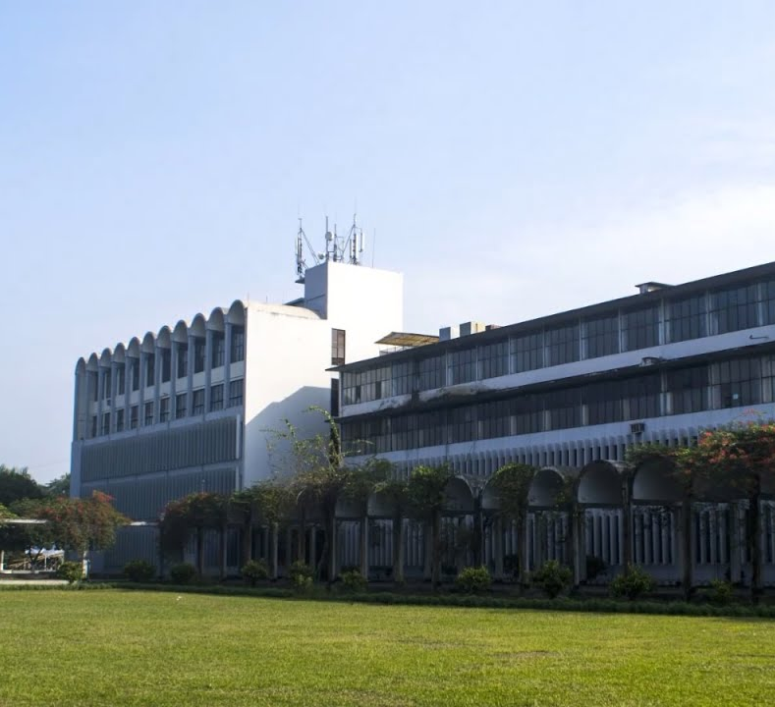
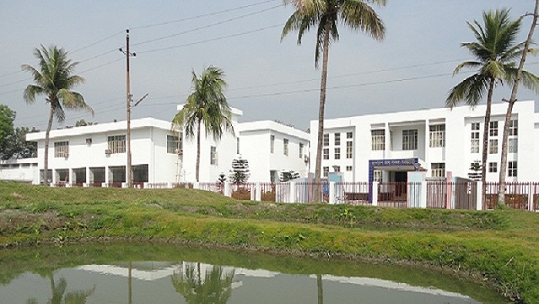
Research Institutes
National Academy for Primary Teachers' Education (NAPE)
BINA
Swadu Pani Matsya Gobeshona Kendro
Primary Training Institute
Teachers' Training College
Women Teachers' Training College
Veterinary Training Institute
The Institute of Radiation Genetics and Plant Breeding

Slide 15
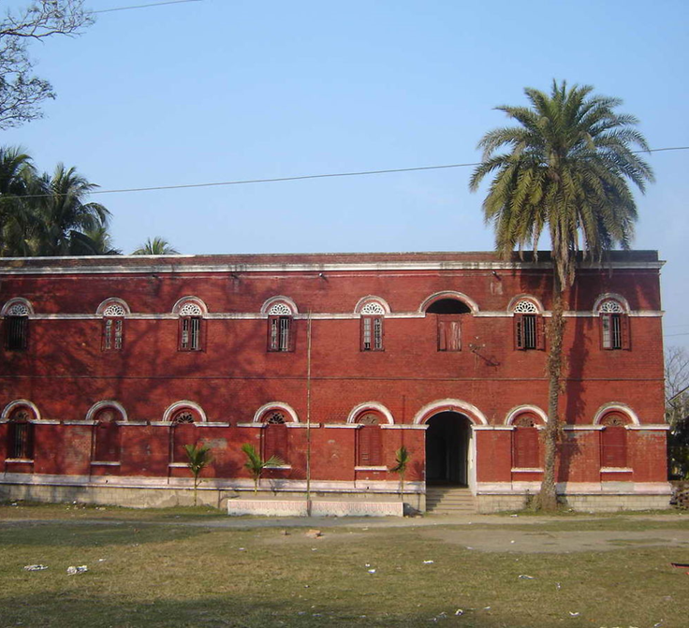

Mymensingh Zilla School
In 1846 it started as an English medium school called 'Hardinge School' at Mr. F. B. Camp's, the then Deputy Collector ofthe East India Company. On 3 November1853 it started as a full-fledged English medium school near Kachari (presentLaboratory School)Bhagwan chandra bose, father of scientist jagadish Chandra bose, was the school’s first headmaster.
Vidyamoyee Govt Girls High School
Vidyamoyee Govt. Girls' High School is a girls’ public secondary school in Mymensingh, Bangladesh.The school was founded by Jagatkishore Acharya Chowdhury, the son of Vidyamoyee Devvya in 1873 during British Raj. The school was founded by Jagatkishore Acharya Chowdhury, son of Vidyamoyee Devvya, as a gesture of love to his mother. Other financial support came from the zamindars of Muktagacha, Gouripur and Krishnanagar.

Slide 16
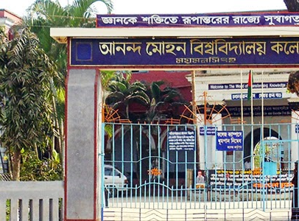
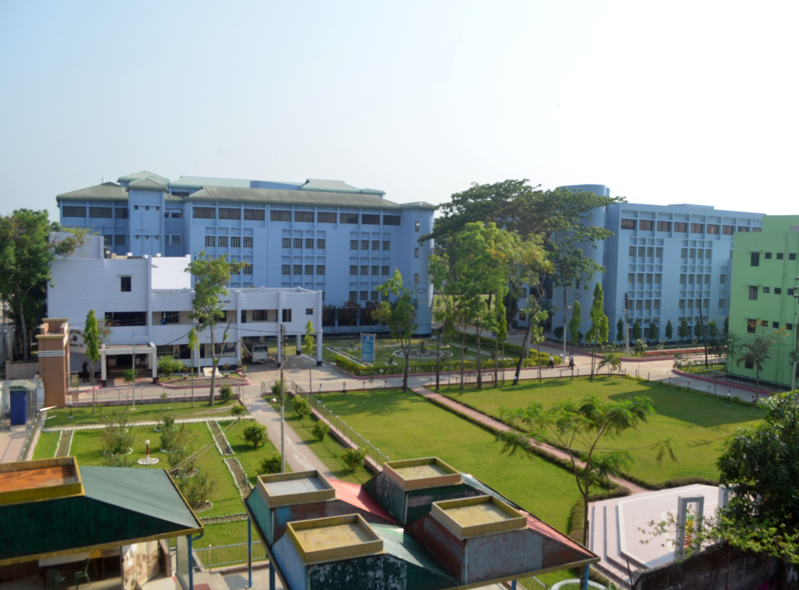
Cantonment Public School & College, Mymensingh
Cantonment Public School and College Mymensingh (CPSCM) is one of the most prestigious and reputed institutes of academic excellence.
Ananda Mohan College
Ananda Mohan College is a fully government-aided public college, affiliated to National University, Bangladesh and Mymensingh Education Board in Mymensingh, Bangladesh. One of the oldest educational premises in South Asia, the institute was established in 1880 by Ananda Mohan Bose as Mymensingh Institution during British Raj. The Ananda Mohan Bose, who founded the city college in 1878, decided to open a branch of it at his hometown in Mymensingh. In 1880, an educational institution was established at the residence of Ananda Mohan as the City Collegiate School. Later, the college section of the institution was shifted to College Road on 1 January 1908 as a college, and it was named after him. In 1964, the college was nationalized.

Slide 17
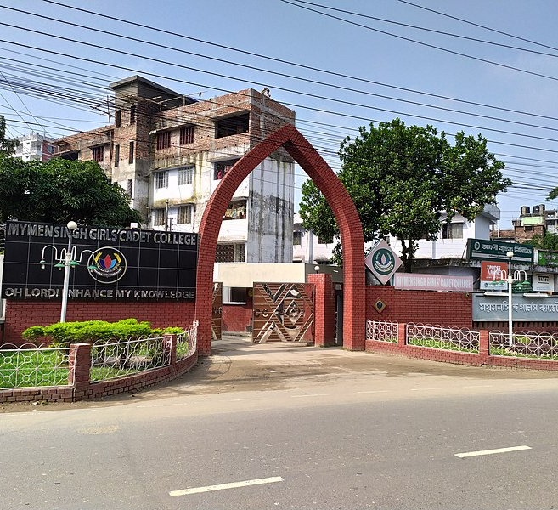
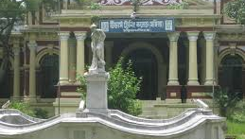
Mymensingh Girls' Cadet College
Mymensingh Girls' Cadet College is a military high school for girls, located in Mymensingh city, Bangladesh, near Charpara. It is the first girls' cadet college in Bangladesh.
Mymensingh Girls' Cadet College was founded on 1 July 1982 with the first intake of cadets starting classes on 19 March 1983 under the guidance of the first principal, Karim Uddin Ahmed. It is situated in Mymensingh district and was the first girls' cadet college in Bangladesh.
Woman Teacher's Training College (Shoshi Lodge)
Women Teachers' Training College, also known as Teachers' Training College (Female) is an educational institution in Mymensingh, Bangladesh. It is the only school of its kind in Bangladesh. As of 1978, it offered bachelor's and master's degrees in Education. Since 1952, the college has been housed in Shashi Lodge, a landmark building on a 9-acre property. The current Shashi Lodge is the second building by this name.

Slide 18
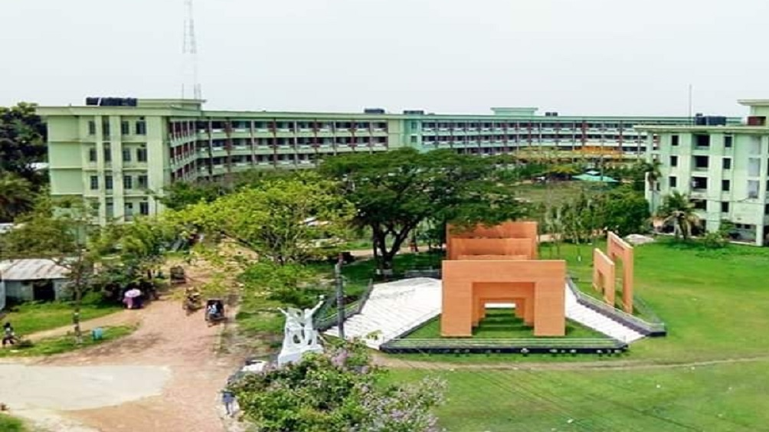
Jatiya kabi kazi Nazrul islam university
Jatiya Kabi Kazi Nazrul Islam University was established by the Government of Bangladesh on 09 May 2006, though the initiative for its establishment was taken some years before, firstly by a non-official group of socio-cultural local elites, namely Greater Mymensingh Cultural Forum.
It was built at Namapara Battola of Trishal in Mymensingh district. Kazi Nazrul Islam lived in this village for some time during his wandering early life. From 1 June 2007, the university started its academic activities.
The university was originally conceived to be built as the first cultural university in Bangladesh, but the JKKNIU Act enacted in 2006 made it a general university with a special focus on liberal-cum-performing arts education and research.

Slide 19
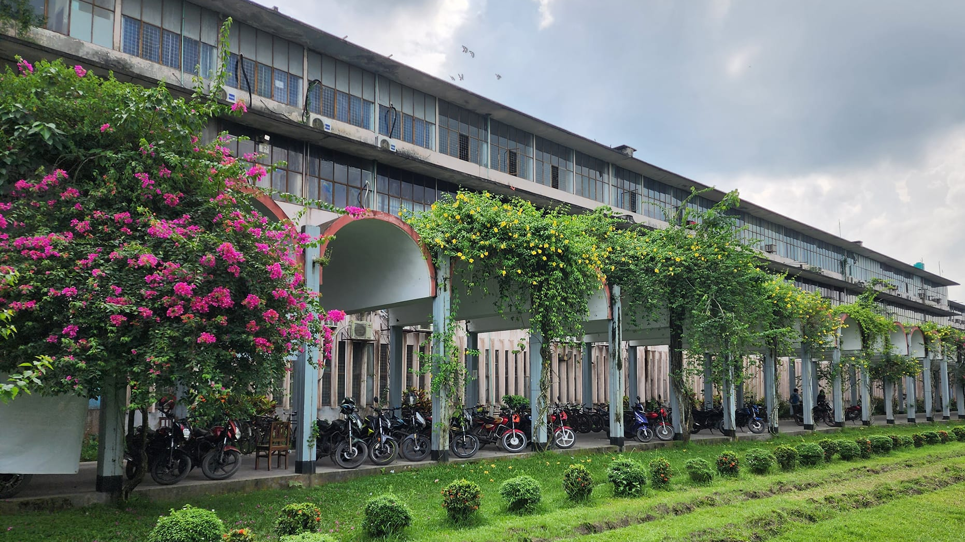
Bangladesh Agricultural University
Bangladesh Agricultural University (BAU) is the premier seat of higher agricultural education and research in the country. Its activities cover all the domains of agricultural sciences having direct bearing on terrestrial and aquatic productivity.
Bangladesh Agricultural University abbreviated as BAU, was established in 1961. The university has 44 departments.
The university's primary mission is to enhance the quality of higher agricultural education and produce skilled agriculturists, scientists, and researchers to drive national agricultural development. As a residential institution, it offers education, research, examinations, degree conferment, and affiliations in all branches of agriculture.

Slide 20
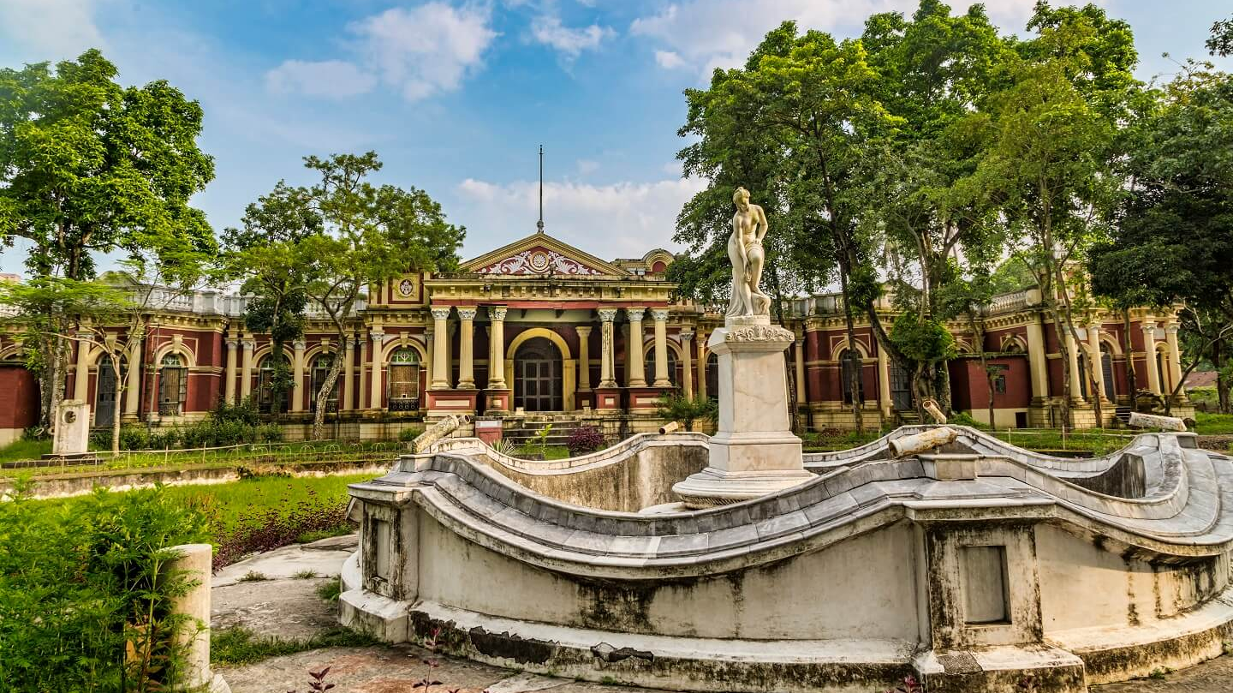
Tourist and historical places of Mymensingh

Slide 21
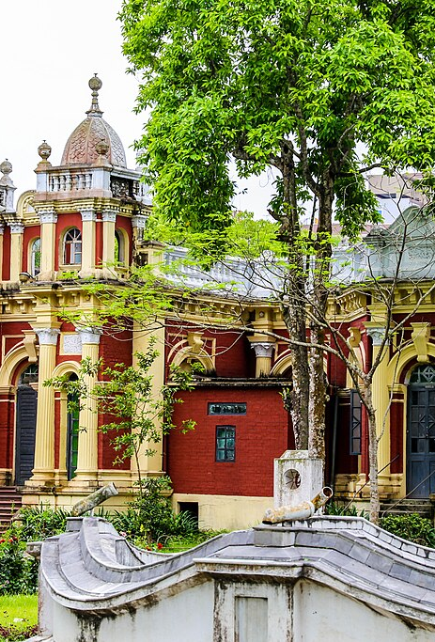
THE SHASHI LODGE
Suryakanta Acharya Chowdhury, the successor of Muktagacha Zamindar dynasty built a luxurious two-storied palace named Shashi Lodge in the city of Mymensingh after the name of his adopted son Shoshikanta. It is one of the most attractive landmarks of Mymensingh city.
The Shashi Lodge, also known as the Rajbari of Mymensingh, was the palace-residence of Maharaja Shashikant Acharya, who was the Maharaja of the Muktagacha Zamindari Estate in Mymensingh of East Bengal during the time of the British Raj in India. The Shashi Lodge, is also named as 'Crystal Palace' in the second half of the 18th century, which was also known as 'Rangmahal'.
This original place was destructed by the massive earthquake in 1897 AD. Then this palace was rebuilt in one-storied between 1905 and 1911 by Shoshikanta. Shashikant Acharya, the adopted son of Suryakanta, completed the construction of the building in 1905. It is fairly a large area, occupying about nine acres of land, and approached through an imposing semi-circular arched gateway. There is a large grassy lawn with an ornamental marble fountain containing a beautiful classical statue in between the palace and the gateway.
Shashi Lodge is a beautiful example of colonial architecture, featuring intricate carvings and decorations. The building is a two-story structure with a central courtyard, and it is known for its unique blend of European and Bengali architectural styles.

Slide 22
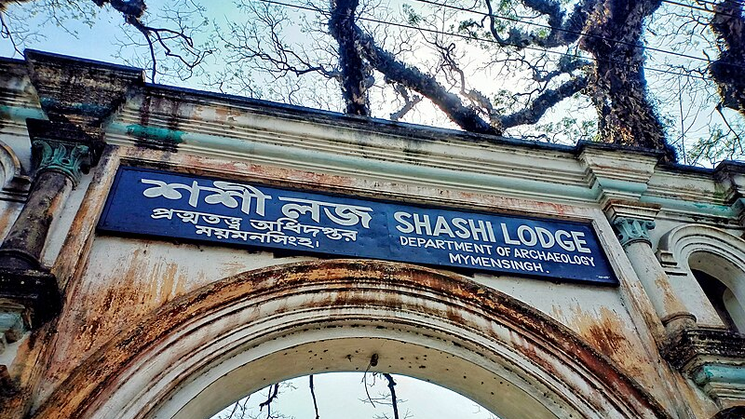
THE SHASHI LODGE
In recent years, Shashi Lodge has undergone extensive restoration work to preserve its historic beauty. The building is now open to the public, and visitors can explore the various rooms and galleries to learn more about its fascinating history.
The building is also a popular location for photography and film shoots, and it has been featured in several movies and television shows.
When the government established Women Teachers Training College at Shashi Lodge in 1952, officials used the main building of the house as the principal’s office and office. Later, On 4 April 2015, the Directorate of Archeology of the Government of Bangladesh acquired Shashi Lodge to set up a museum.

Slide 23
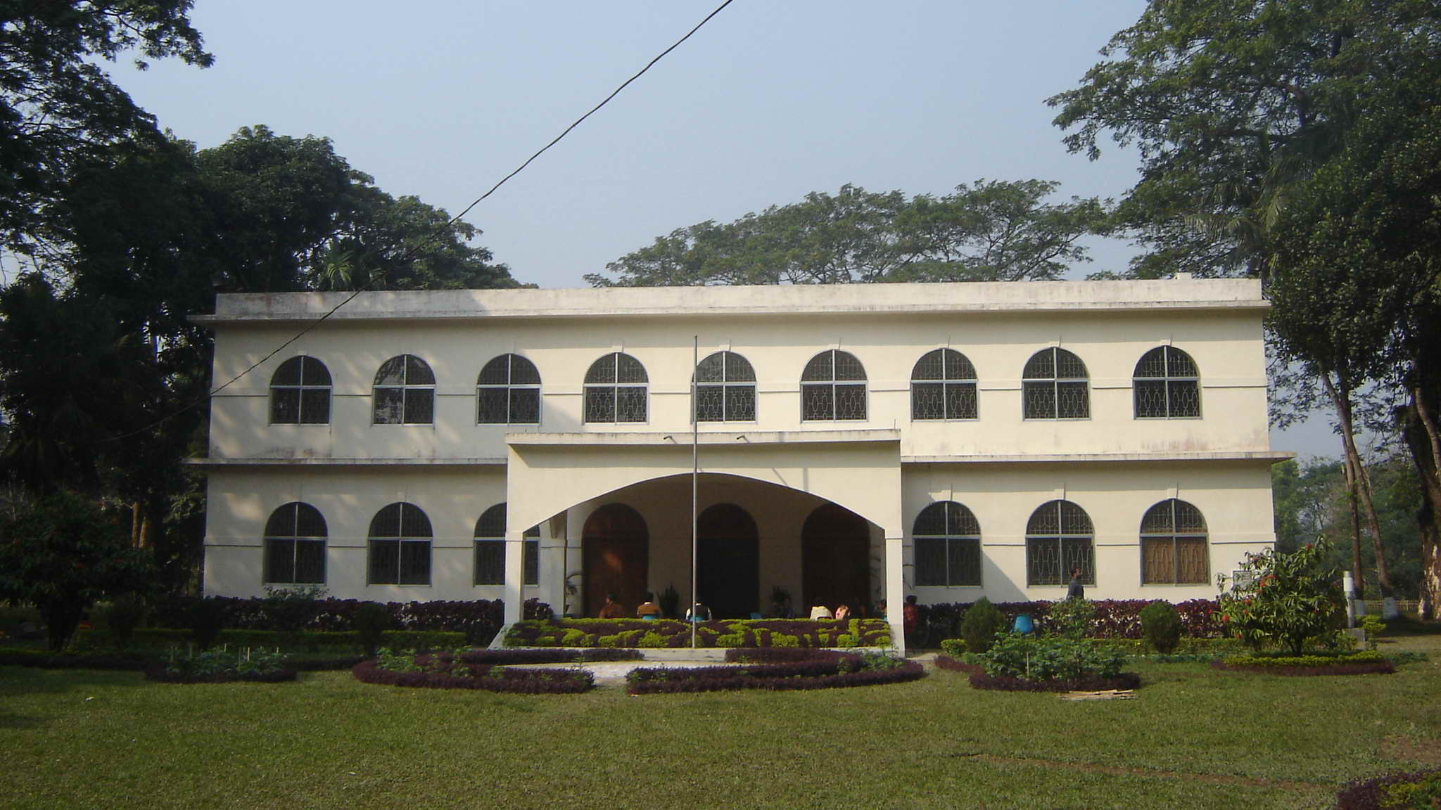
Shilpacharya Zainul Abedin Sangrahashala
Nestled in the heart of Mymensingh, Bangladesh, the Shilpacharya Zainul Abedin Sangrahashala stands as a beacon of cultural heritage and artistic brilliance. The Museum of Fine Arts, named after the renowned Bangladeshi artist Zainul Abedin, serves as a repository of his works and a tribute to his immense contributions to the art world. Established to honor the legacy of the “Shilpacharya” or “Great Teacher of Art,” the museum offers a deep dive into the life and works of Zainul Abedin, whose artistic vision played a pivotal role in shaping modern Bangladeshi art.
The Museum was established in 1975.

Slide 24
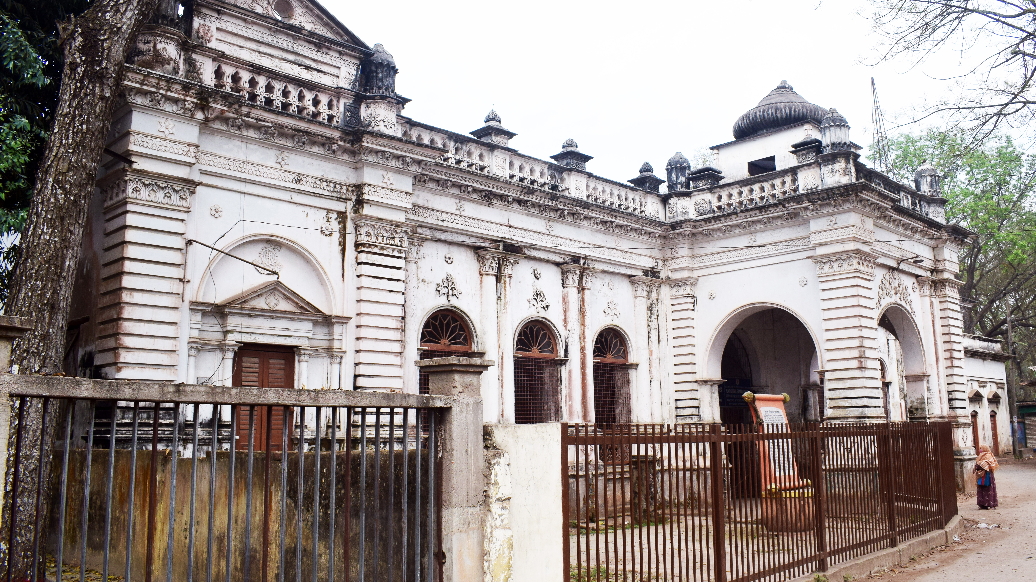
Muktagasa Zamindar House
Muktagacha Zamindar House was built in the late 18th century by the Zamindars (landlords) of Muktagacha. The zamindari system was prevalent in India during the British colonial period, and Muktagacha was one of the many zamindaris in the region.
The house is a fine example of traditional Bengali architecture, featuring intricate woodwork, curved roofs, and spacious courtyards.
It is believed that the Zamindars actually came from the Natore or Bogra of our North Bengal. When the first ruler named Srikrishna Acharya arrived here, a local inhabitant named Muktaram Kormokar welcomed them with a large lampstand that was made from brass. In that portion of our country, people call a lampstand as Gachha. This gratitude pleased the Zamindar and they have renamed the area as Muktagacha using that inhabitant’s name and the lamp stand’s local name.
The Muktagacha Zamindar House is considered an important cultural site in Bangladesh. It has been used as a location for film shoots, and is often visited by tourists and history enthusiasts.
The house is currently owned by the government of Bangladesh and is maintained by the Department of Archaeology. It has been declared a protected monument by the government.

Slide 25
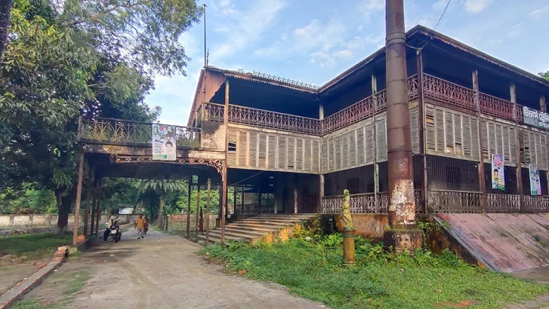
Alexander Castle
Alexander Castle is a palace located in the city of Mymensingh, Bangladesh. Alexander Castle is one of the ancient structures of Mymensingh city.
It is located near Court-Kachari in the heart of the city.T he Alexander Castle was built by Maharaja Suryakanta Acharya Chowdhury, a wealthy landowner and philanthropist of the region. He named the castle after his son Alexander. The palace was built in 1889 AD. It was popularly known as "Iron Kuthi" due to the use of iron in building construction.
At present, it is being used as the library of the Teacher Training College. The building was named 'Alexandra Castle' after Alexandra, wife of the then Emperor Edward VII of India. Later, it became popularly known as Alexander Castle or Iron Castle.
The castle is an excellent example of the European architectural style of the 19th century. It has a unique blend of Gothic and Renaissance styles, with a distinct touch of Bengali architecture.
It is now a protected monument under the Bangladesh Department of Archaeology. However, the castle has fallen into disrepair and needs urgent restoration work to preserve its historical significance.
The castle is a popular tourist attraction in the Mymensingh district. Many people visit the castle to admire its unique architecture and learn about its history.

Slide 26
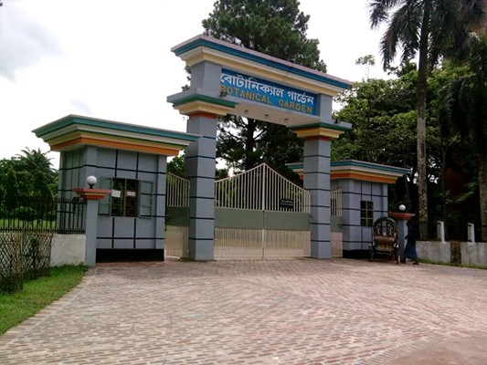
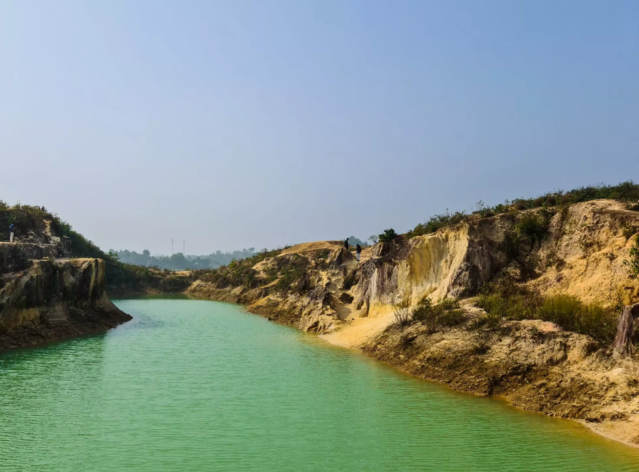
BIRISHIRI
Birishiri is Known for its scenic beauty and the serene Shomeshwari River, Birishiri offers picturesque landscapes ideal for nature enthusiasts and photographers. Located in Durgapur, Birishiri. It is located at Shushong Durgapur Thana of Netrakona district, is a dream destination for travelers. It's a wonderful place with river,hills, smalland the green countryside. The main attraction of Birishiri is garo pahar, shomashwari river kangsha river,ceramic hill and blue water etc. There is also an ethnic museum at Birishiri.
The Botanical Garden
The Botanical Garden in Mymensingh is a lush oasis of greenery and biodiversity, offering a peaceful retreat for nature lovers and researchers alike. Located within the Bangladesh Agricultural University campus, the garden showcases a wide variety of plant species, providing an excellent opportunity for botanical studies and strolls.
It was later renamed the Bangladesh National Herbarium and is now a division of the Ministry of Environment and Forests.
The garden began its journey in 1963 .The Botanical Garden is one of the many attractions on the BKU campus. This garden has not only added beauty to the university but has also created a new dimension in the entire city of Mymensingh.

Slide 27
Madhutila Ecopark: Located in Nalitabari of Sherpur district, Madhutila Ecopark is an attractive place surrounded by hilly beauty. It is also known as a wildlife conservation center. Various wildlife including elephants, Maya deer, monkeys can be seen.
Haor region :The haor spread across Mithamoin, Itna, Ashtagram areas of Kishoreganj district is a paradise for nature lovers. During the rainy season, a wonderful combination of water and sky can be seen here. Boat trips in the haor provide a unique experience. Boat marina, fishing scene, floating villages.
Durgapur Someswari River: The Someswari River flowing through Netrakona’s Durgapur is famous for its clear water and sandy banks. The river becomes beautiful during the rainy season. Boat trips and visiting tribal villages.
Gouripur Rajbari: This ancient Rajbari located in Gouripur of Mymensingh division is a historical establishment. This beautiful Rajbari still reminds us of the zamindari stories of the past.
Kangsa River:The Kangsa River flowing through Netrakona is known for its natural beauty. Boat trips here become very enjoyable during the rainy season.

Slide 28
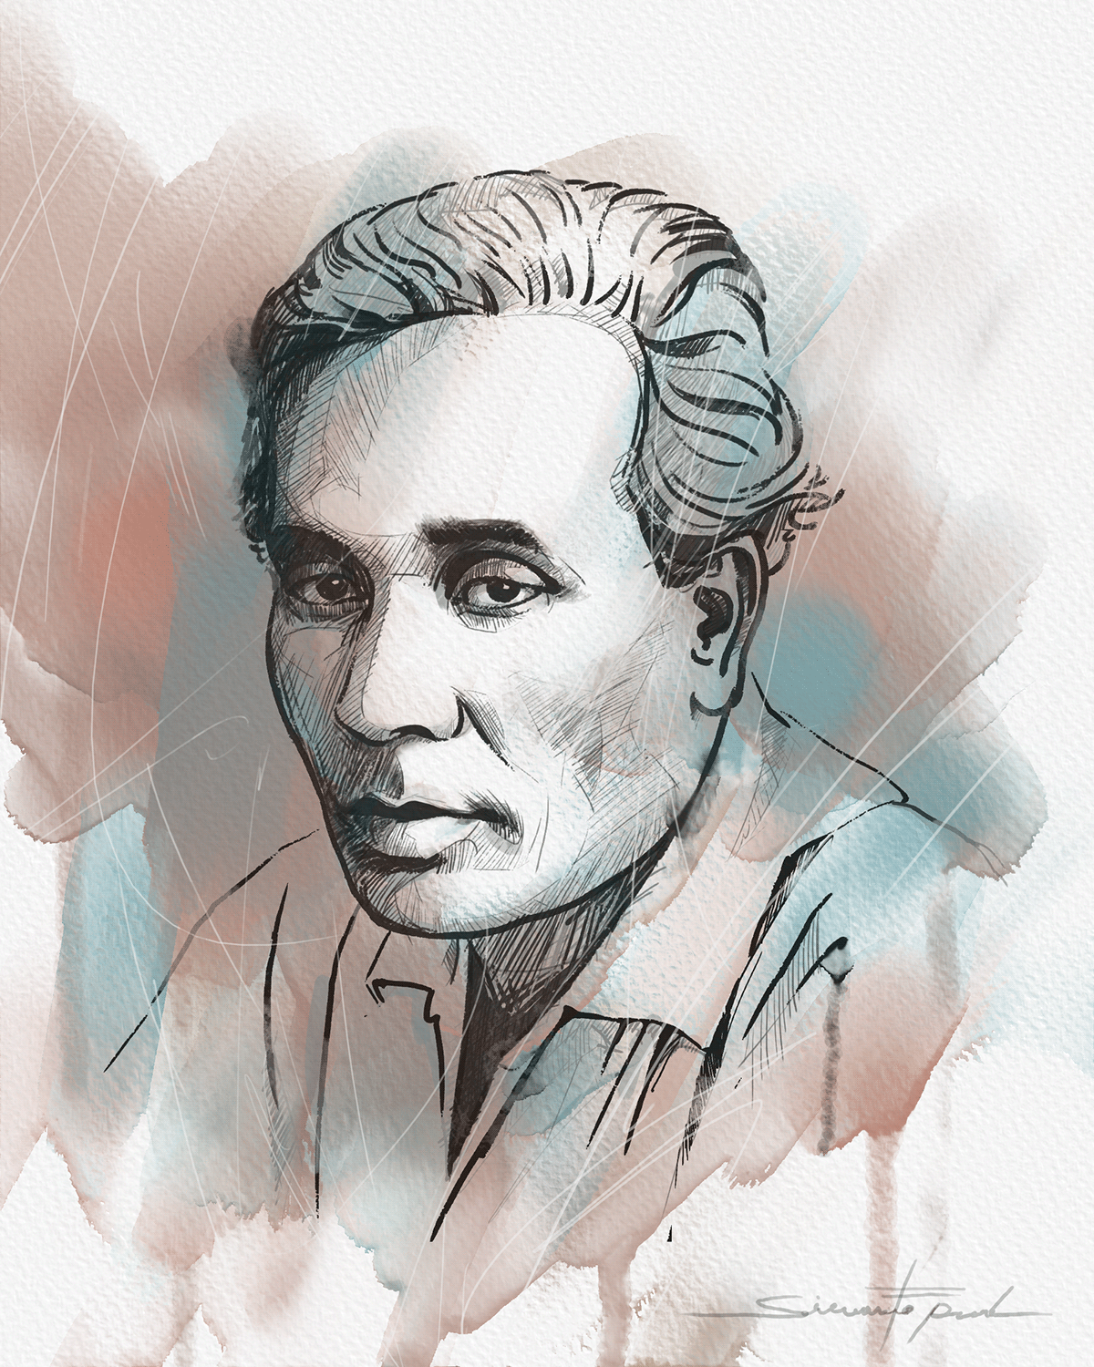
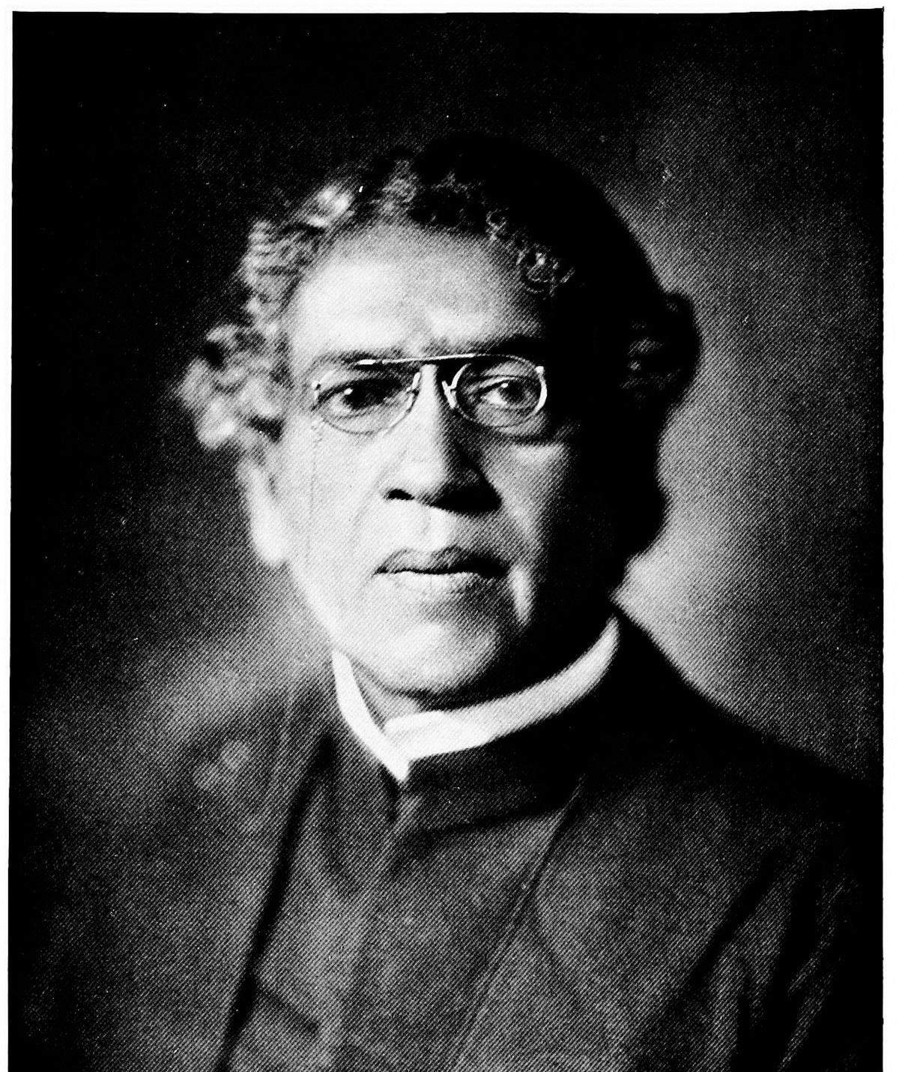
Zainul Abedin
Zainul Abedin (1914-1976) an artist of exceptional talent and international repute. He played a pioneering role in the modern art movement in Bangladesh that began, by all accounts, with the setting up of the Government Institute of Arts and Crafts (now Institute of Fine Arts) in 1948 in Dhaka of which he was the founding principal.
He was well known for his leadership qualities in organising artists and art activities in a place that had practically no recent history of institutional or professional art.
Sir Jagadish Chandra Bose
Sir Jagadish Chandra Bose (30 November 1858 – 23 November 1937), also spelled Jagdish and Jagadis, was a biologist, physicist, botanist and an early writer of science fiction. He pioneered the investigation of radio and microwave optics, made significant contributions to plant science, and laid the foundations of experimental science in the Indian subcontinent.
Renowned Personality

Slide 29
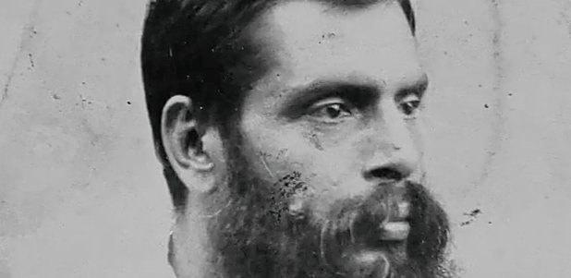
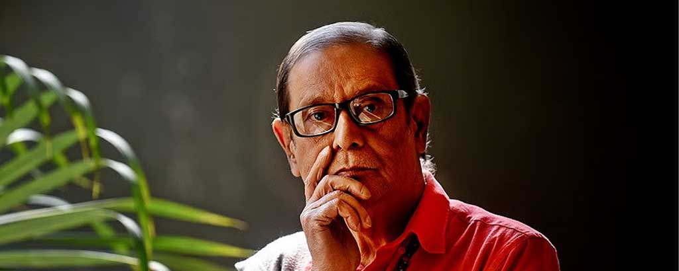
Helal Hafiz
Helal Hafiz (7 October 1948 – 13 December 2024) was a Bangladeshi poet. He won Bangla academy literary award (2013). Hafiz died in Dhaka on 13 December 2024, at the age of 76.
Upendrakishore Ray Chowdhury
Upendrakishore Ray Chowdhury, Born on (12 may 1863 – 20 december 1915), was a Bengali writer and painter.

Slide 30
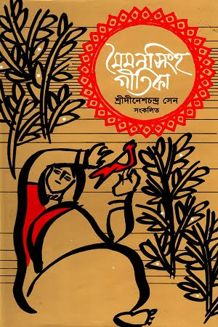
Mymensingh song
Mymensingh Geetika is a collection of ancient folk songs of the Mymensingh region. Professor Dinesh Chandra Sen of the University of Calcutta, with the help of local collectors, collected and edited these folk songs from the greater Mymensingh district and published them in a book called Mymensingh Geetika (1923). The book won the hearts of even the educated people with its great content and artistic quality.
There are 10 songs in the Mymensingh Geetika, namely—Mahua, Malua, Chandrabati, Kamala, Dewan Bhabbana, Dasyu Kenaram's Pala, Roopbati, Kanka and Leela, Kajalrekha and Dewana Medina.

Slide 31
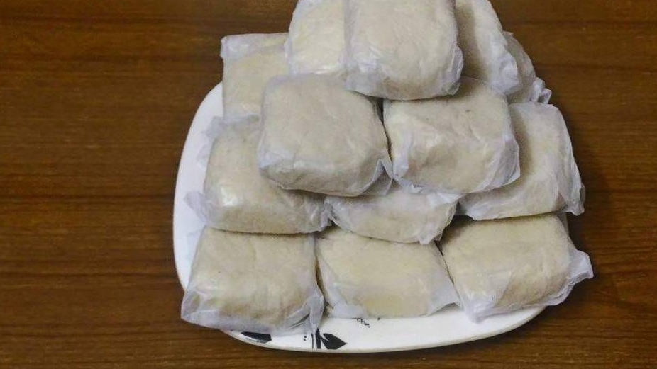
Food
With rich culture Mymensingh inherited an array of cuisine from famous Muktagachar Monda to Balis Chamcham of Netrokona, from Chepa to Red Biroi Rice. Mohashol of Netrokona comes to satiate the culinary desire of tradition-loving Bangladeshi.
Monda, is a traditional Bangladeshi sweet originated in Muktagachha Upazila, Bangladesh. The sweet, first made in 1824,is reputed in Bangladesh and many countries for its originality, taste and flavour.
Ram Gopal Pal, better known as Gopal Pal, first prepared this sweetmeat in 1824. He offered it to Maharaja Suryakanta Acharya Chowdhury, one of the leading zamindars of Muktagacha. Maharaja Suryakanta was full of praise for Gopal Pal and encouraged him to prepare monda to entertain guests who visited the zamindars. The zamindars also extended financial support to Gopal Pal for the expansion of the business.
Now Sree Ramendranath Pal and Brothers run the business. They are the fifth generation of the Gopal Pal family.

Slide 32
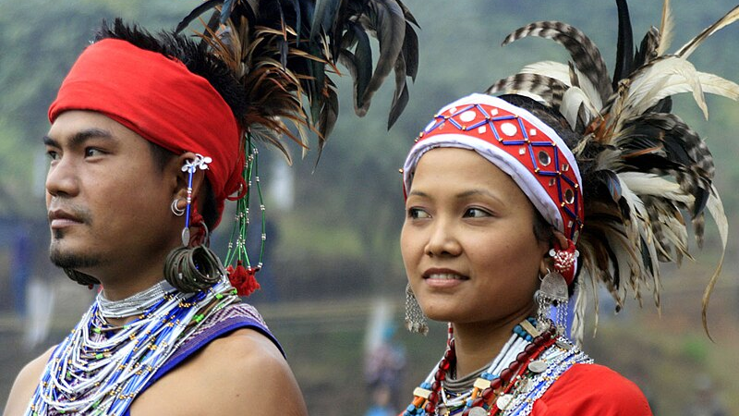
Tribes
The Chakmas, the Marmas, the Tripuras, the Tanchangya, Santals, the Garo are tribal people in Bangladesh. The tribals people has still cling to their age-old unique culture and lifestyle amidst the nature sustaining continue. The tribals began to live at Durgapur, Haluaghat, Sherpur and Madhupur region in greater Mymensingh of Bangladesh. Most of the tribals people Garo people lives in there, originally from Yang Si Kiang and Hoang Ho basin of China via Assam, Mayanmar and India.
They would like to introduce themselves in their language as Mandi, the daughter of nature. They worship nature and its objects.

Slide 33
Problems & Solutions
There is huge potentiality to exploit richness of Mymensingh division that comes with some embedded problems. Despite having contributed enormously during her heyday, Mymensingh seems to have been falling sharply over the past few decades. Things have not improved drastically even after declaring it as a division. Lack of standard road, drainage facilities, throttling traffic and mushrooming of autoriksas have paralyzed life of people. All tiers of administration need to find sustainable solutions to all these problems.

Slide 34

References
https://en.wikipedia.org/wiki/Mymensingh
https://mymensingh-division.blogspot.com/p/educational-institutes.html
https://en.wikipedia.org/wiki/Mymensingh_Zilla_School
https://mymensingh.info/%E0%A6%AC%E0%A6%BF%E0%A6%A6%E0%A7%8D%E0%A6%AF%E0%A6%BE%E0%A6%AE%E0%A6%AF%E0%A6%BC%E0%A7%80-%E0%A6%B8%E0%A6%B0%E0%A6%95%E0%A6%BE%E0%A6%B0%E0%A7%80-%E0%A6%AC%E0%A6%BE%E0%A6%B2%E0%A6%BF%E0%A6%95%E0%A6%BE/
https://en.wikipedia.org/wiki/Women_Teachers_Training_College
"Mymensingh" . Encyclopædia Britannica
https://www.citypopulation.de/en/bangladesh/div/admin/4__mymensingh
https://www.fao.org/agris/data-provider/bangladesh-agricultural-university
https://jkkniu.edu.bd/
https://www.mymensingh.gov.bd/en/site/page/SbLH-%E0%A6%9C%E0%A7%87%E0%A6%B2%E0%A6%BE%E0%A6%B0-%E0%A6%AA%E0%A6%9F%E0%A6%AD%E0%A7%82%E0%A6%AE%E0%A6%BF
https://beautifulbangladesh.gov.bd/cat/heritage/71
https://beautifulbangladesh.gov.bd/cat/heritage/73
https://blog.triptend.com/shilpacharya-zainul-abedin-sangrahashala/
https://www.touristplaces.com.bd/mymensingh/botanical-garden/

